Slide 1
The Impact of Depression and Anxiety on Maternal Perceptions
Client : Jennifer McCabe, Clinical Psychology
Consultants : Xiaoyu Shen, Sunah Kim, Tae Woo Kim
Professor : Rhonda DeCook

Slide 2
Research Goal Figuring out how anxiety and depression is related to parenting stress and parenting stress coming from difficult child behavior

Slide 3
Data Collection
Survey question on 52 mothers
Simply put, each set of questions measure anxiety, depression, and parenting stress etc.
Example
were you so restless or jittery that you paced up and down or couldn't sit still? → measure anxiety
Think carefully and count the number of things which your child does that bother you. For example, dawdles, refuses to listen, overactive, cries, interrupts, fights, whines, etc. → measure parenting stress

Slide 4
Data and Variables
Explanatory Variables | Response Variables
Social Anxiety Generalized Anxiety Depression + Age, Marital Status, and Education | 1. Parenting Stress Index
 | 2. Difficult Child Index

Slide 5
Hypothesis 1
Social Anxiety
Generalized Anxiety
Parenting Stress
Depression
Others
Hypothesis 2
Social Anxiety
Parenting Stress
Generalized Anxiety
Depression
Difficult Child
Others

Slide 6
Analysis of Data
Method | We wanted to see…
Multiple Regression (2 times) | 1. Multi-collinearty 2. Significance 3. Coefficient
Factor Analysis | To see whether she could create a new difficult child index

Slide 7
Multi-Collinearity is okay
 |  | Model 1 | Model 2
 |  | VIF | VIF
 | (Constant)
 | Age | 1.582 | 1.582
 | Education | 1.173 | 1.173
 | Marital Status | 1.576 | 1.576
 | Social Anxiety | 1.249 | 1.249
 | Depression | 1.596 | 1.596
 | Generalized Anxiety | 1.585 | 1.585

Slide 8
Hypothesis 1
Model :
Parenting Stress = age + education + maritalstatus + Social anxiety + Depression + generalized anxiety
Coefficientsª
Model |  | Unstandardized Coefficients |  | Standardized Coefficients | t | Sig.
 |  | B | Std. Error | Beta
1 | (Constant) | 125.990 | 12.595 |  | 10.003 | .000
 | Age | .075 | .036 | .290 | 2.076 | .044
 | Education | -.161 | 1.450 | -.013 | -.111 | .912
 | Marital Status | -4.251 | 3.094 | -.192 | -1.374 | .176
 | Social Anxiety | -4.635 | 2.084 | -.277 | -2.224 | .031
 | Depression | -8.704 | 2.436 | -.502 | -3.573 | .001
 | Generalized Anxiety | 1.229 | .745 | .231 | 1.649 | .106
a. Dependent Variable: PSI Total Scale

Slide 9
Hypothesis 2
Model :
Parenting Stress from difficult child = age + education + maritalstatus + Social anxiety + Depression + generalized anxiety
Coefficientsª
Model |  | Unstandardized Coefficients |  | Standardized Coefficients | t | Sig.
 |  | B | Std. Error | Beta
1 | (Constant) | 2.343 | .434 |  | 5.395 | .000
 | Age | -.002 | .001 | -.214 | -1.342 | .186
 | Education | .108 | .050 | .297 | 2.163 | .036
 | Marital Status | .102 | .107 | .152 | .956 | .344
 | Social Anxiety | .157 | .072 | .310 | 2.188 | .034
 | Depression | .108 | .084 | .206 | 1.291 | .203
 | Generalized Anxiety | .011 | .026 | .068 | .428 | .671
a. Dependent Variable: Difficult child composite item mean

Slide 10
Another thing she wanted to do was..
Originally, she had two response variable
→ Parenting stress
→ Parenting stress coming from difficult child behavior.
Then she realized that some questions from parenting stress are related to difficult child behavior
So, she wanted to rearrange her questions and make each set of questions to measure what it is supposed to measure.

Slide 11
Visually,
36 Parenting stress Questions in total
89 difficult child
questions
Only 12 questions related to difficult child used
101 Questions for a new Difficult Child Index

Slide 12
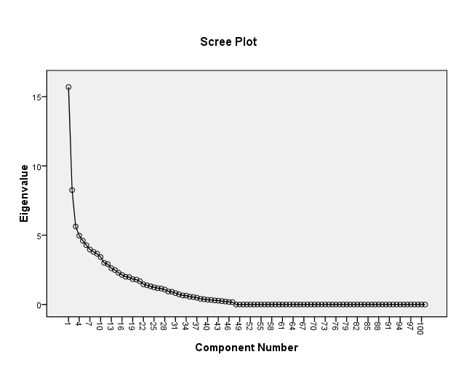
Factor Analysis

Slide 13
Remaining Task for Jennifer
Checking representativeness of her data. One way could be T-test between ‘ongoing’ and ‘dropped’ group
Restructuring or redesigning the survey

